Slide 1
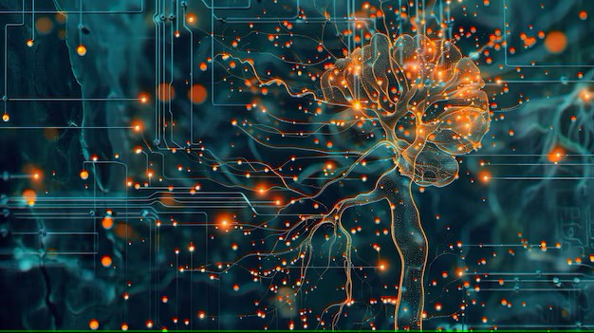



Week-10 (Discussion)
1st Apr, 2025
Deep Learning
Prof. Sudarshan Iyenger
Professor and Head of the Department
Department of Computer Science and Engineering
IIT Ropar
Ayan Paul
PMRF Research Scholar
IIT Kharagpur

Slide 2
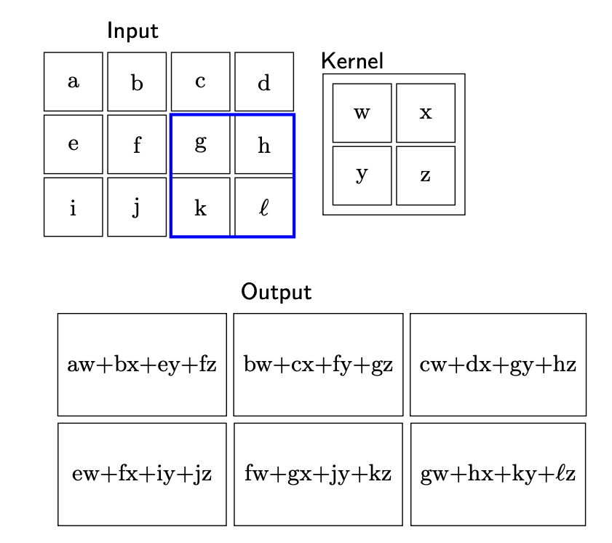
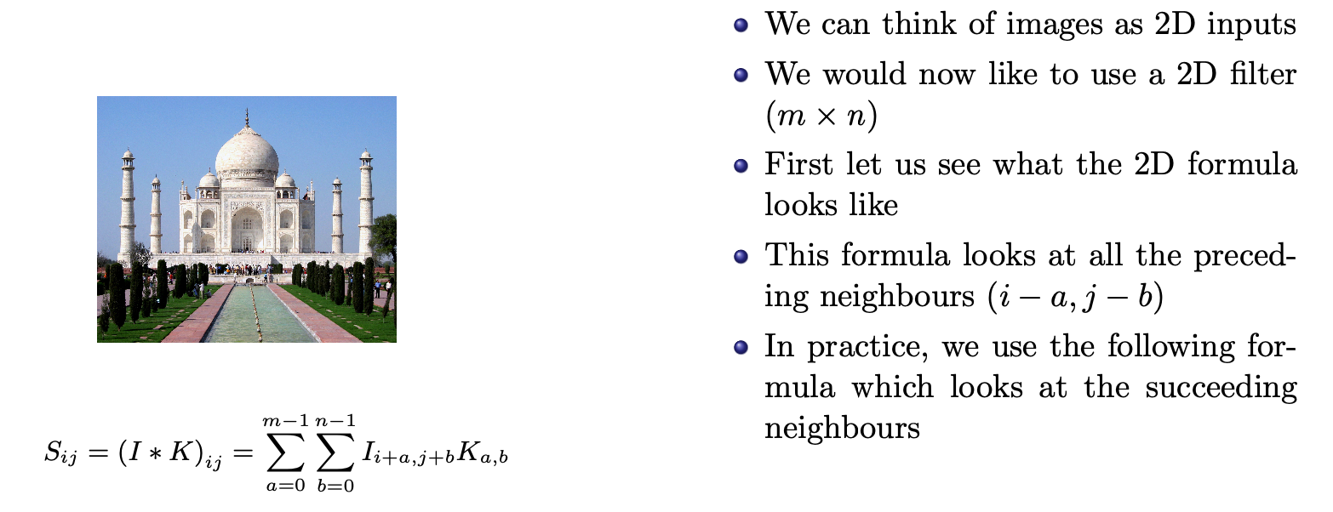
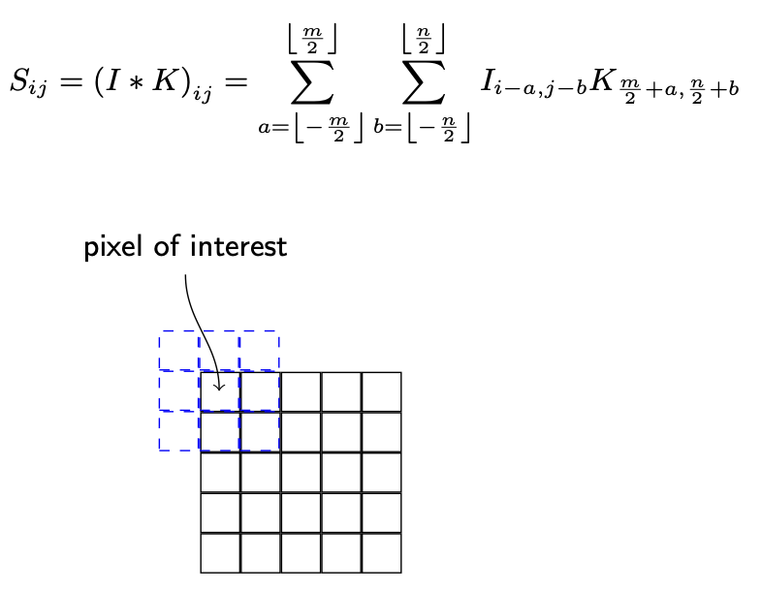
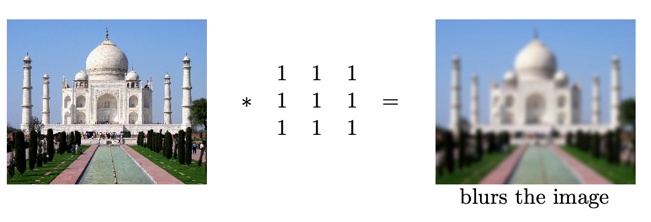
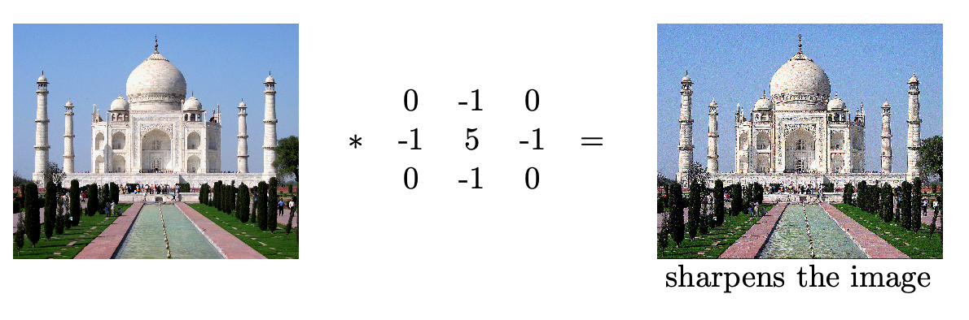
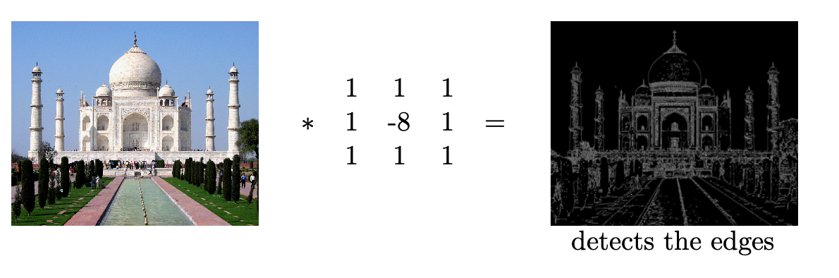
Convolution Operation
Examples of Image Convolutions

Slide 3
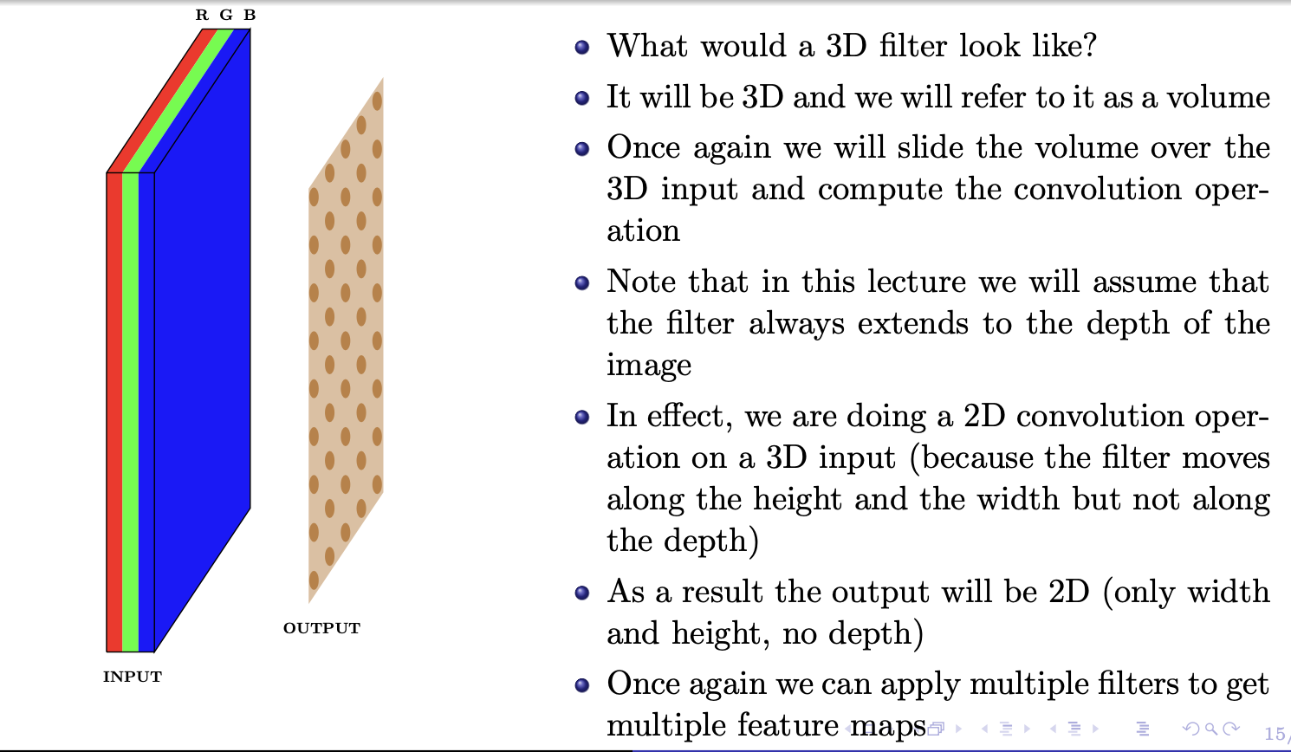
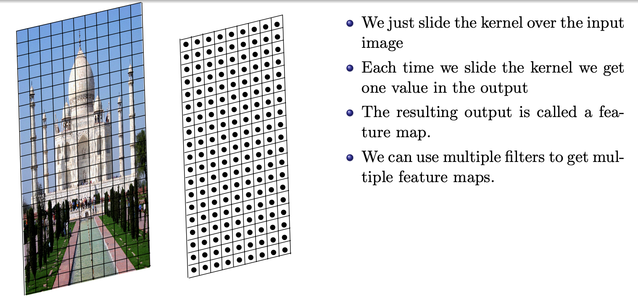
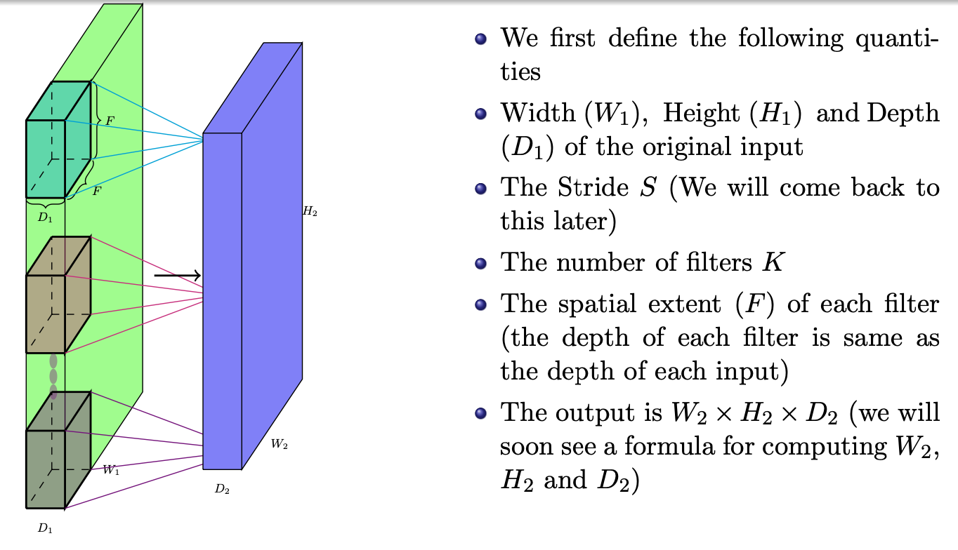
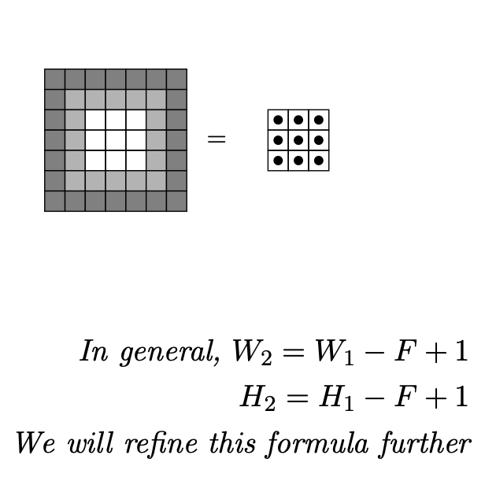
Feature Maps
Relation between input size, output size and filter size

Slide 4
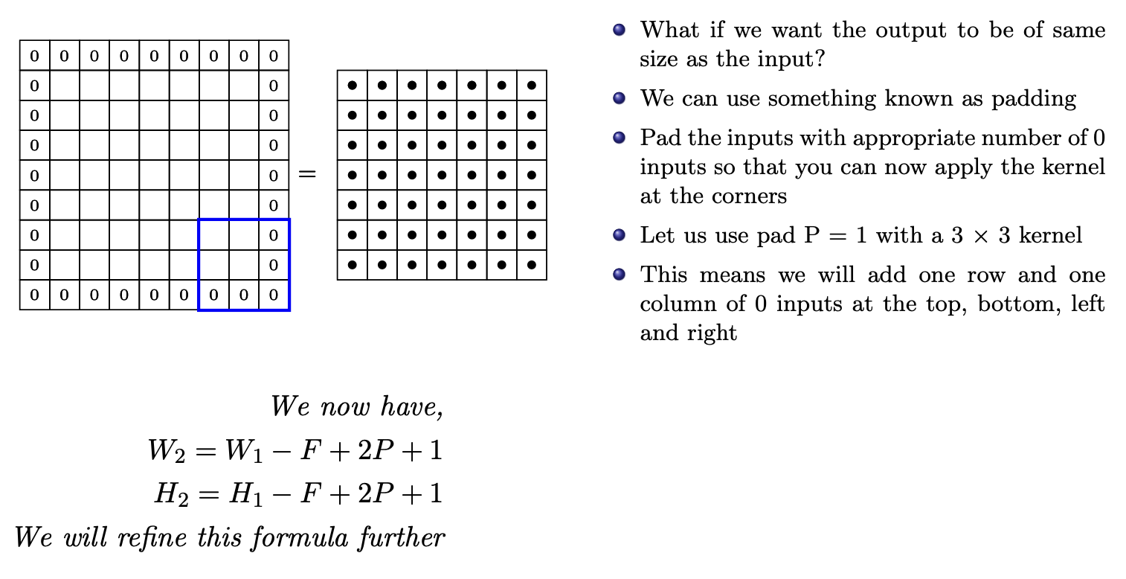
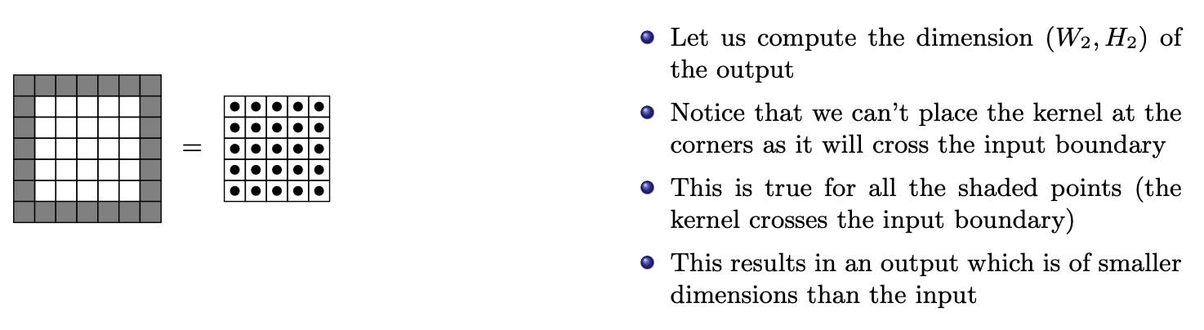
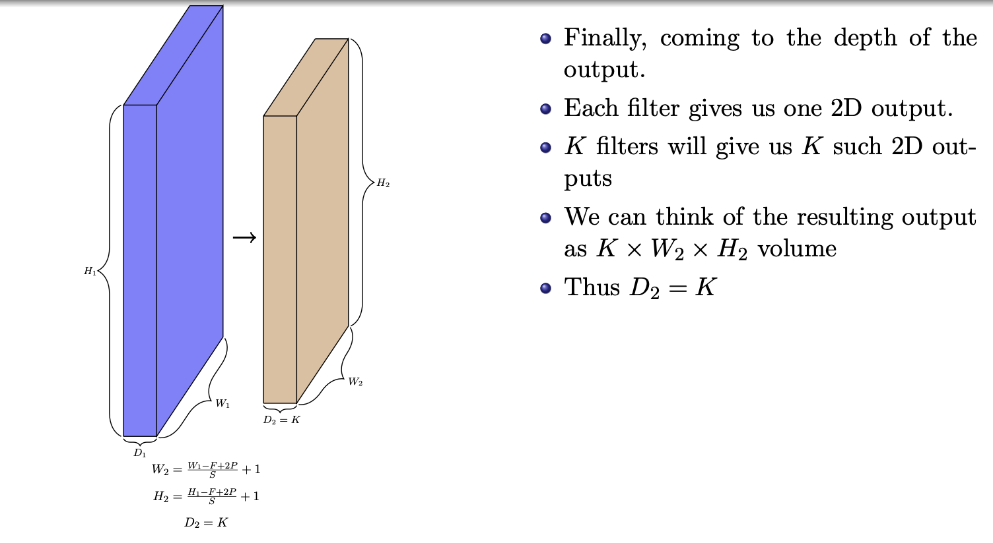
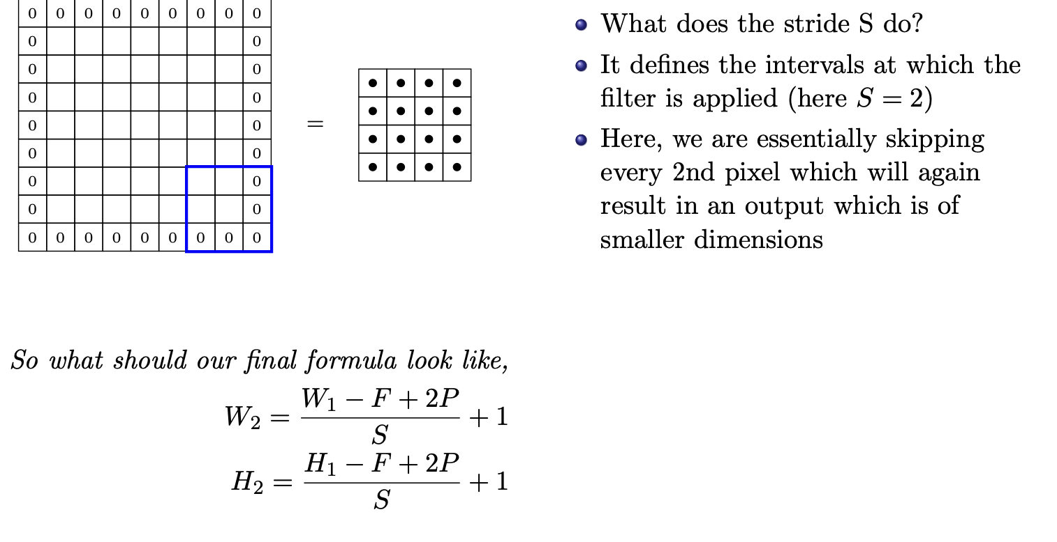
Padding
Stride
Depth

Slide 5
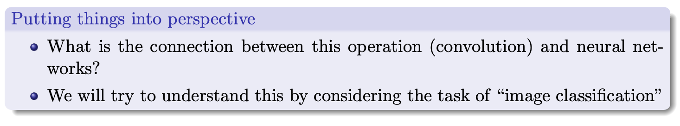
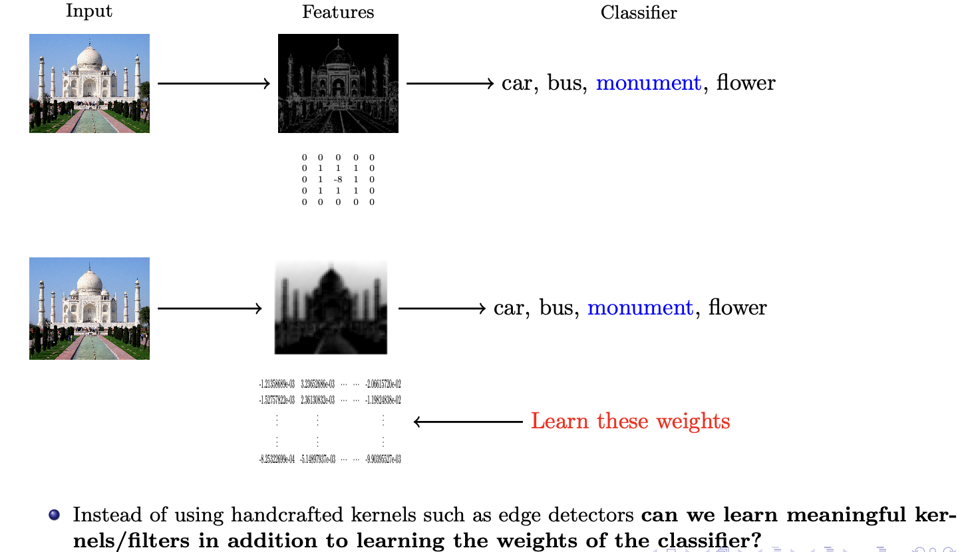
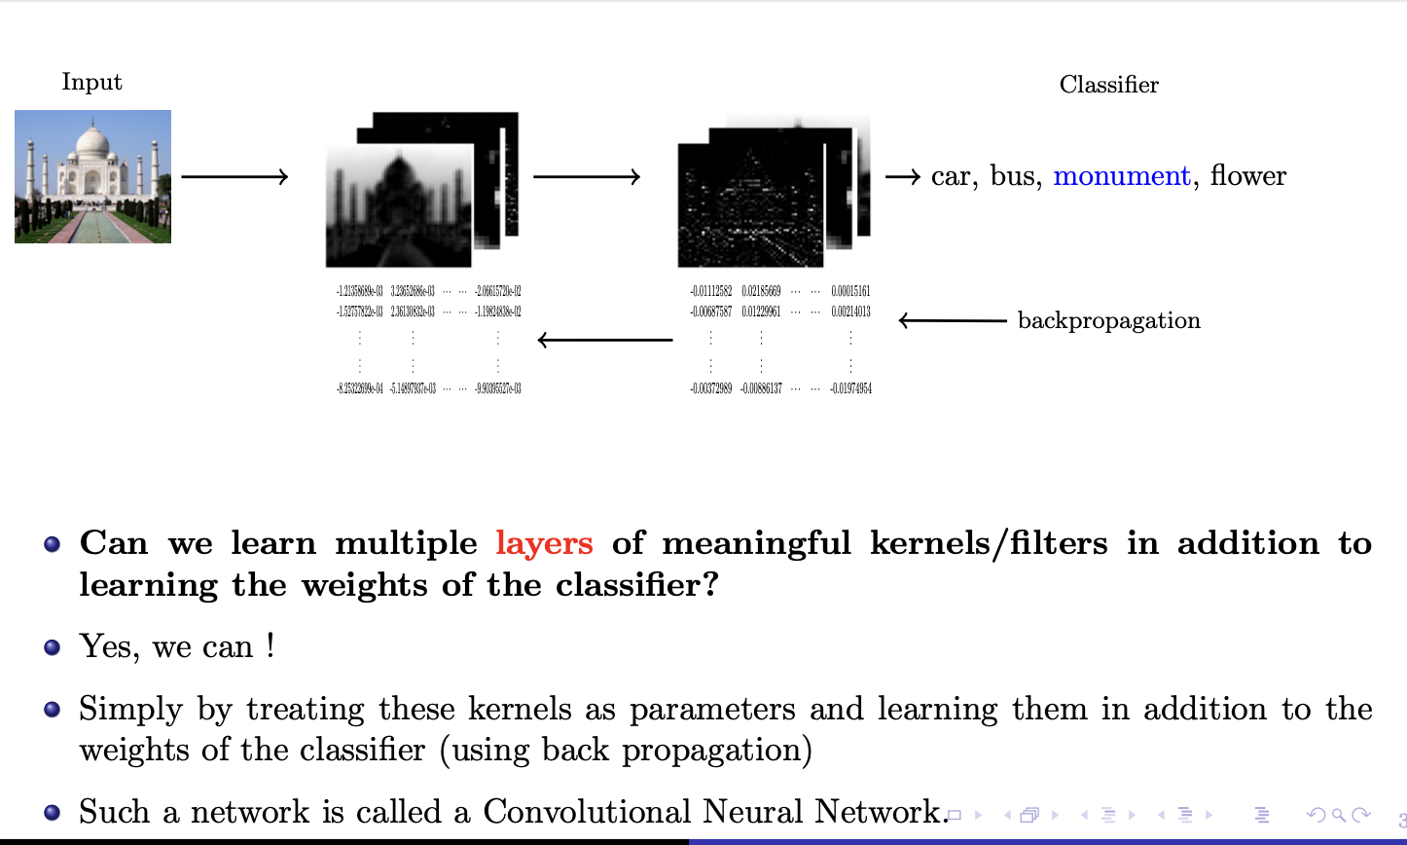
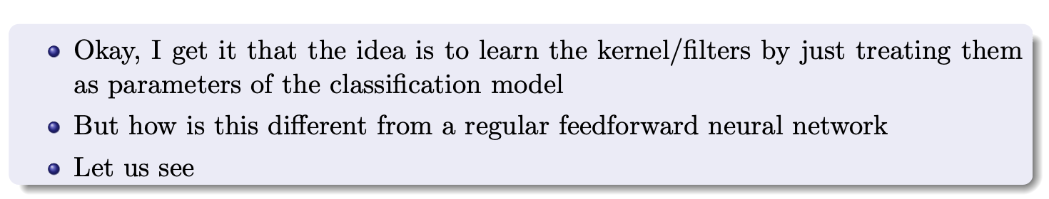
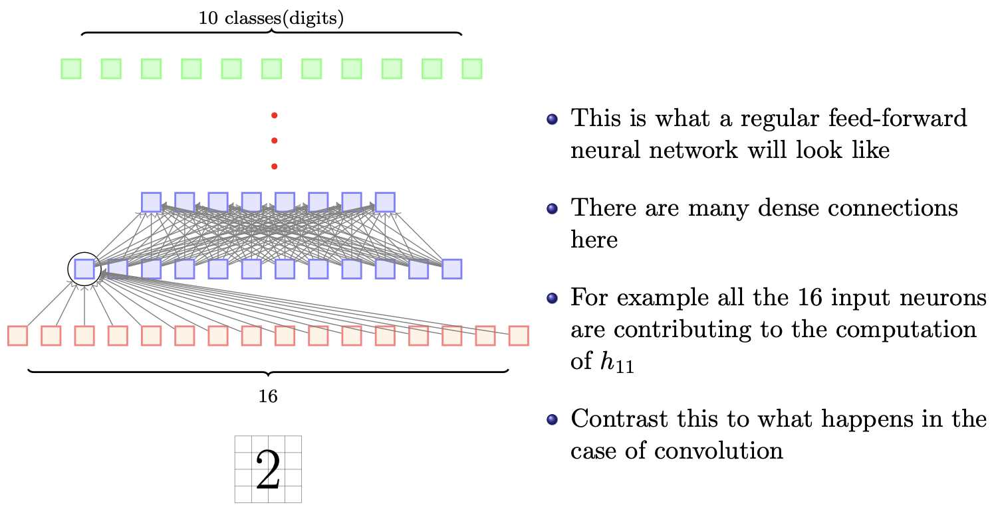
Convolutional Neural Networks

Slide 6
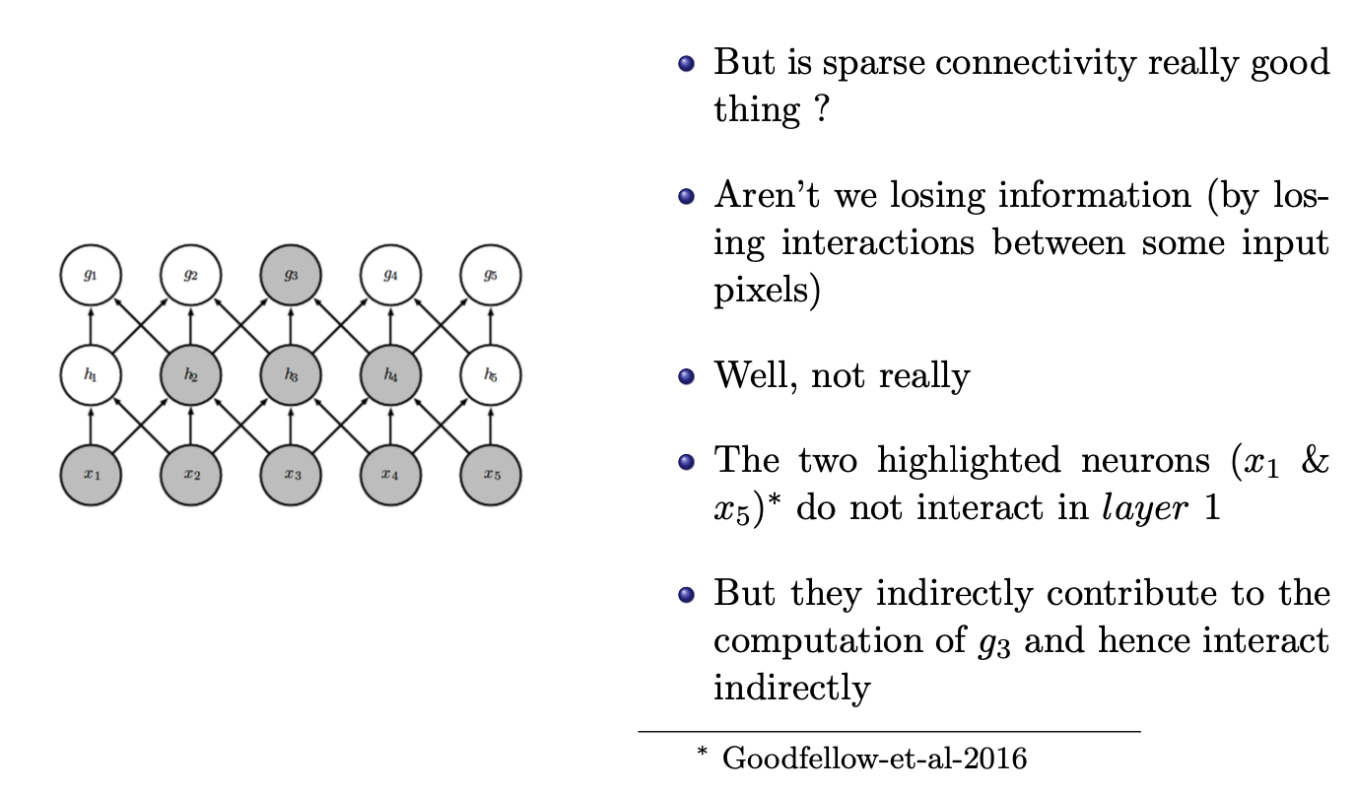
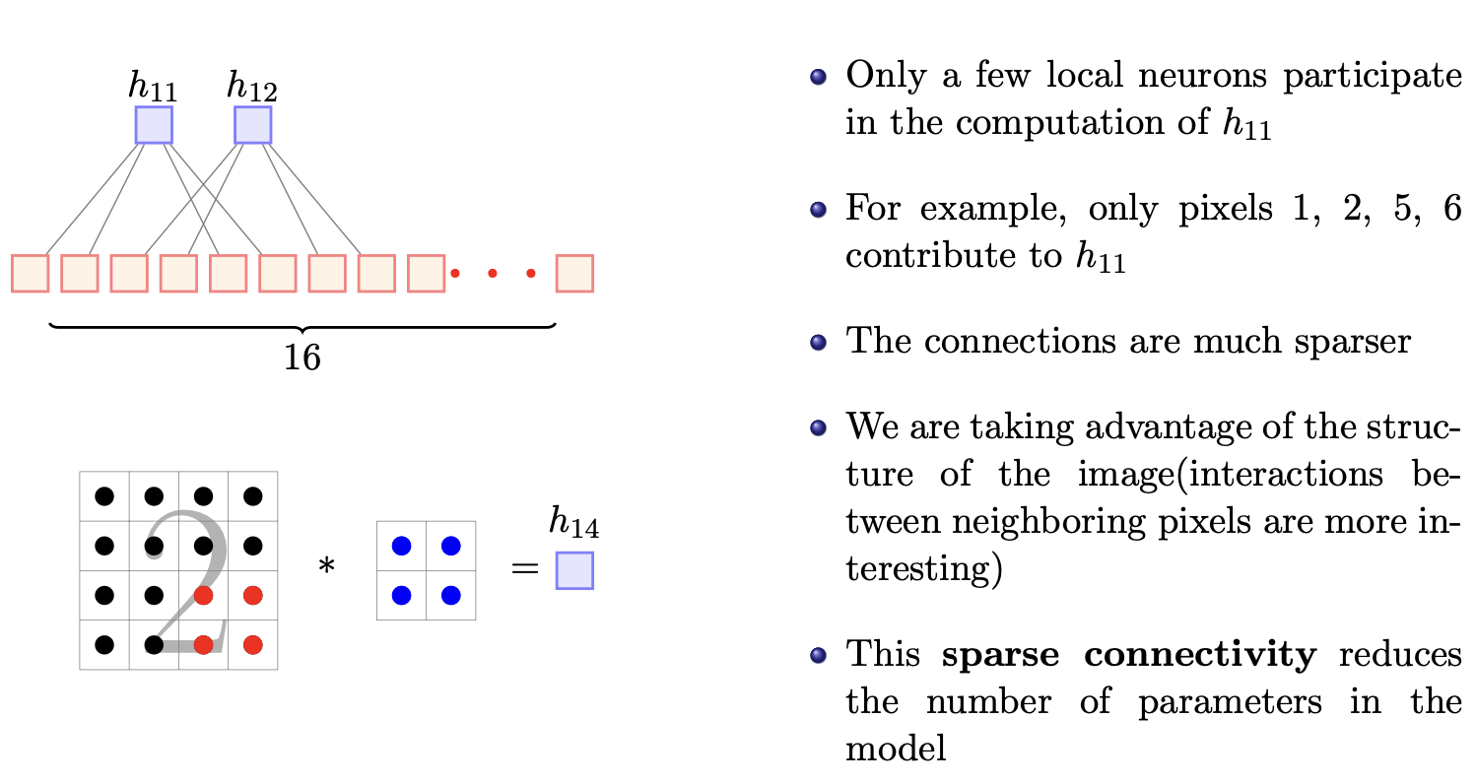
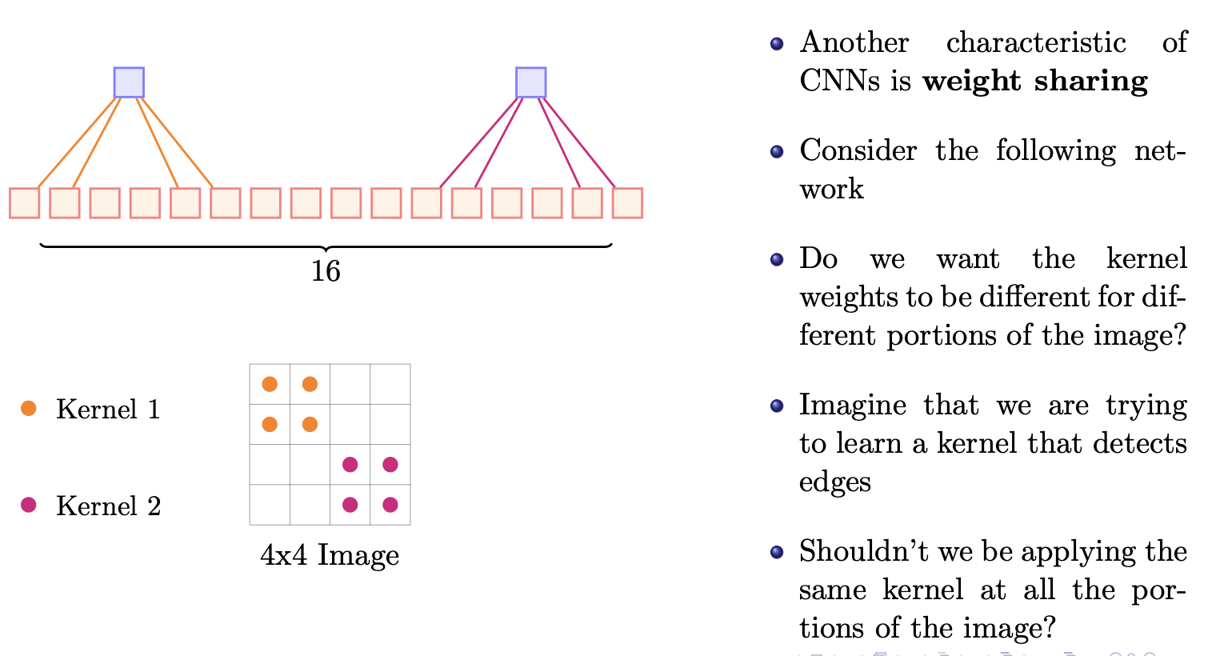
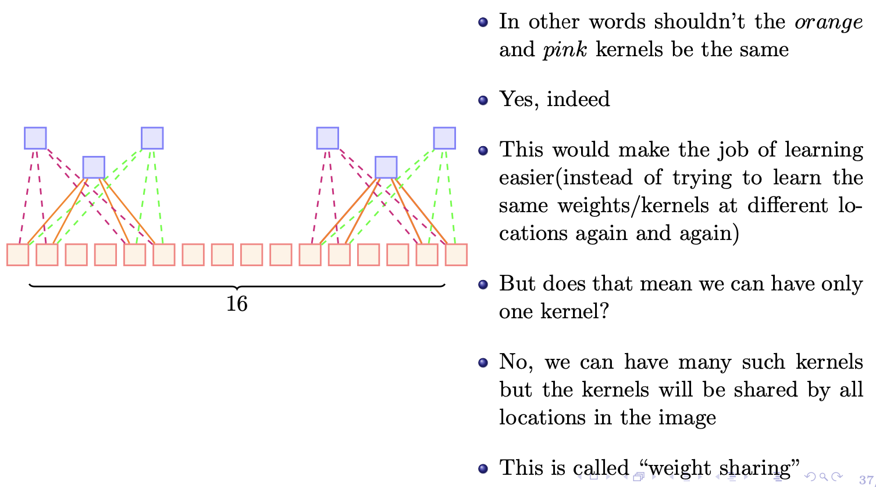
Sparse Connectivity
Weight Sharing

Slide 7
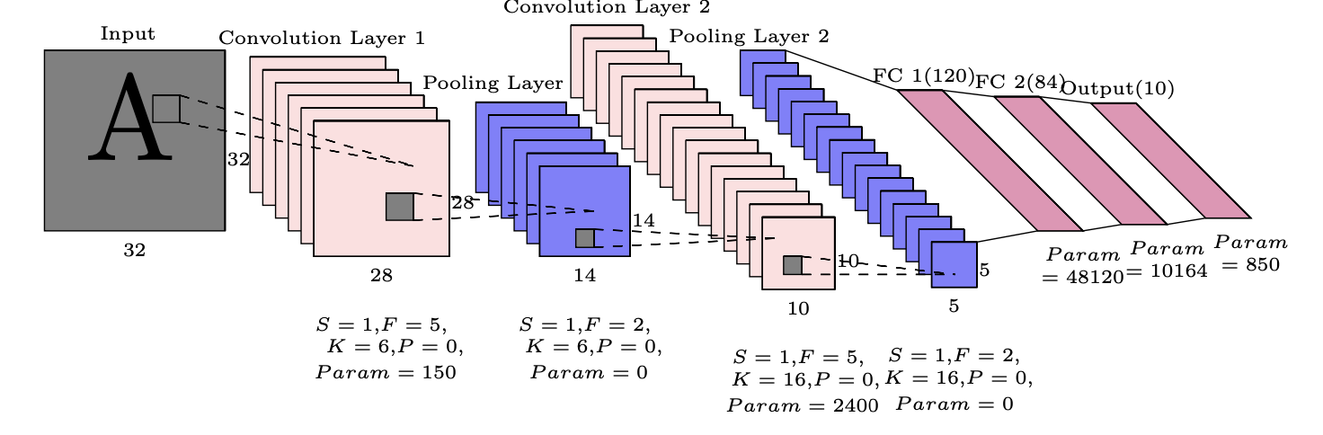
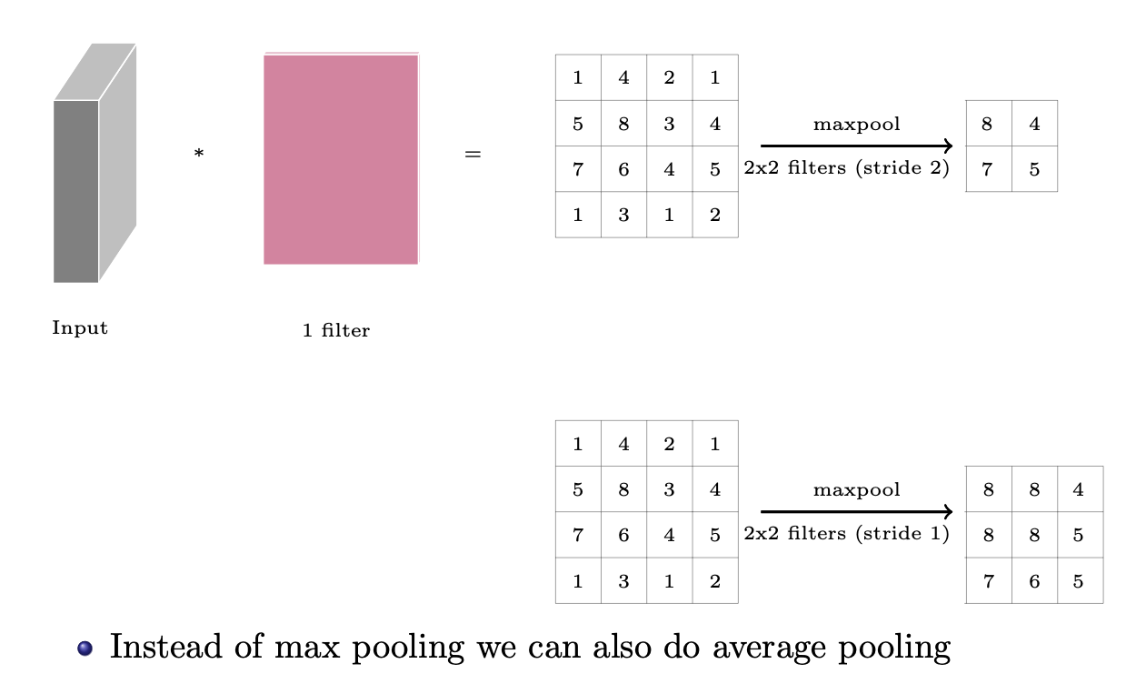
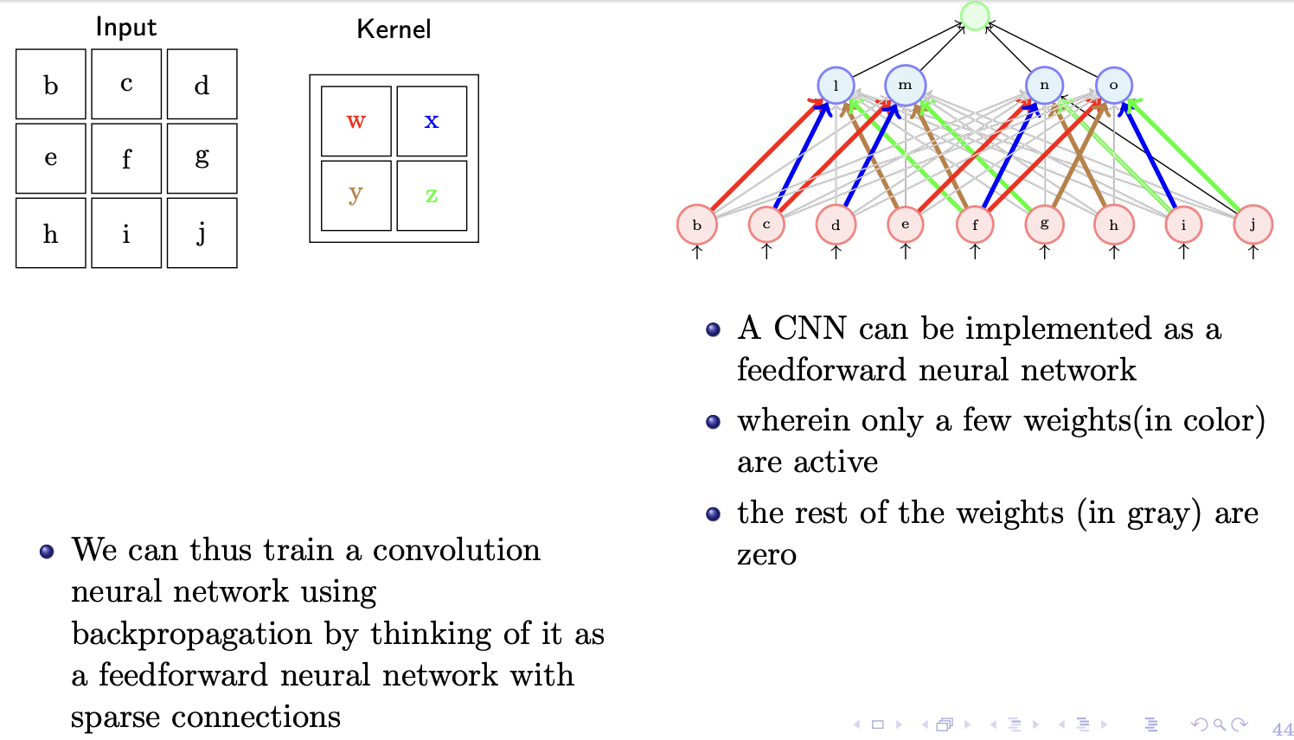
How a Convolutional Neural Network looks like
Pooling
Training CNN

Slide 8
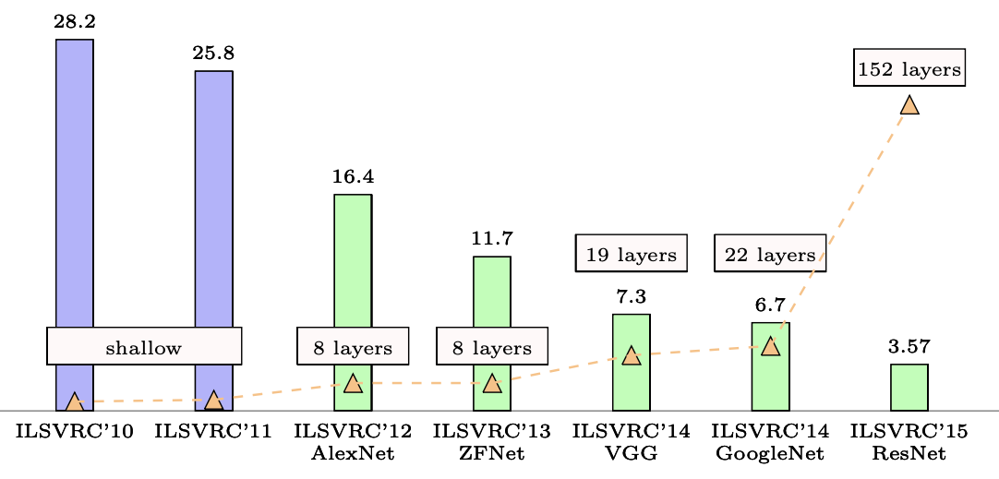
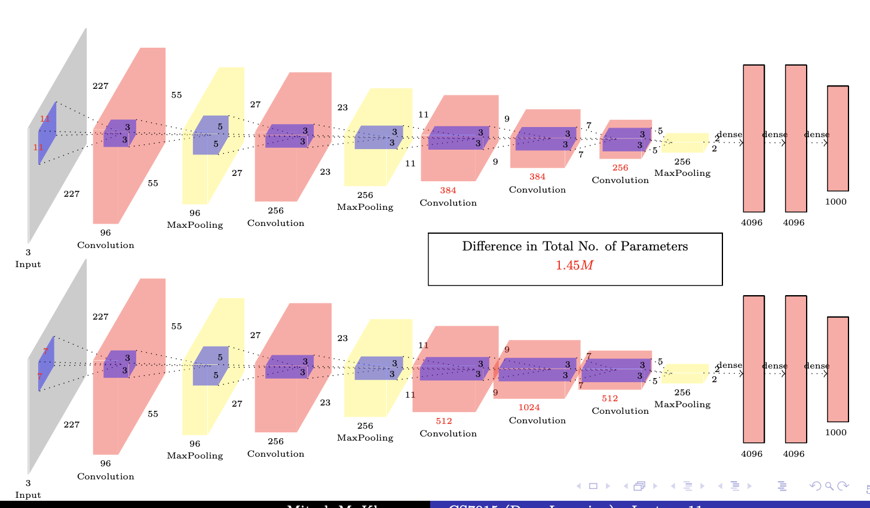
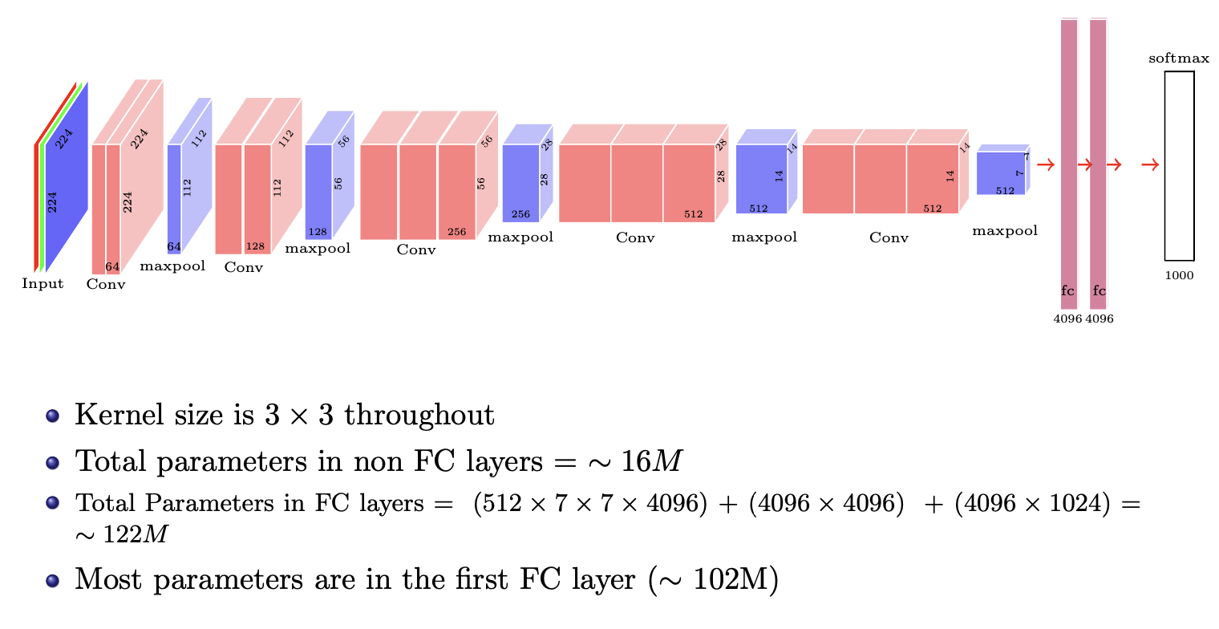
CNNs (success stories on ImageNet)
AlexNet vs. ZFNet
VGGNet

Slide 9
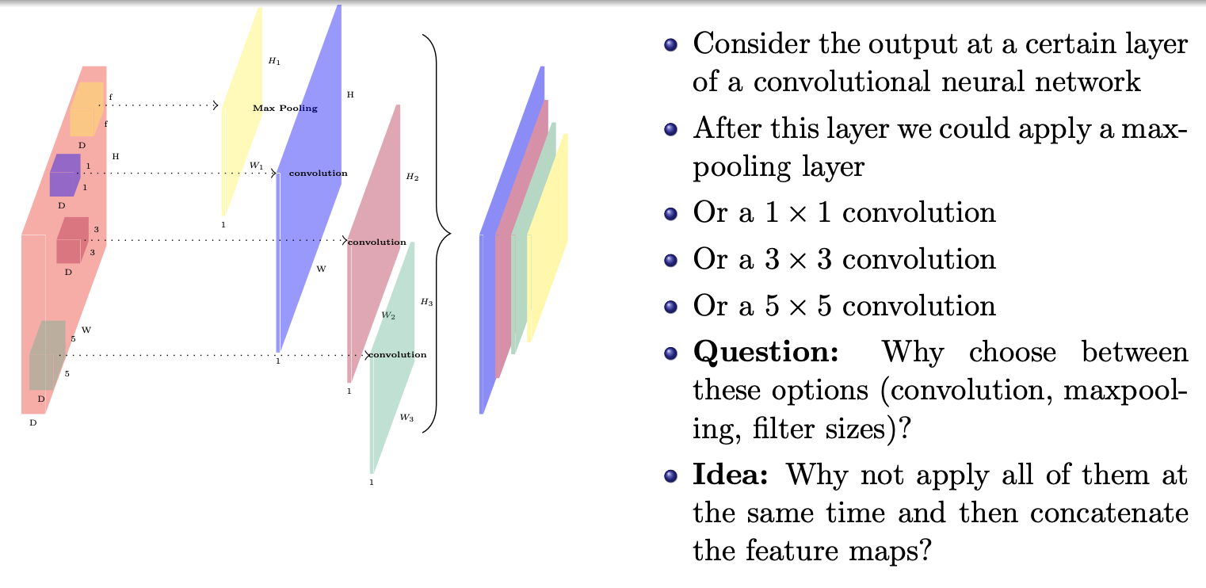
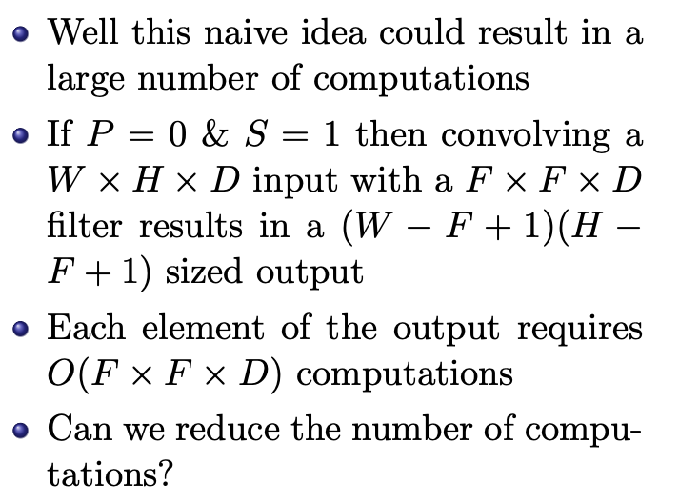
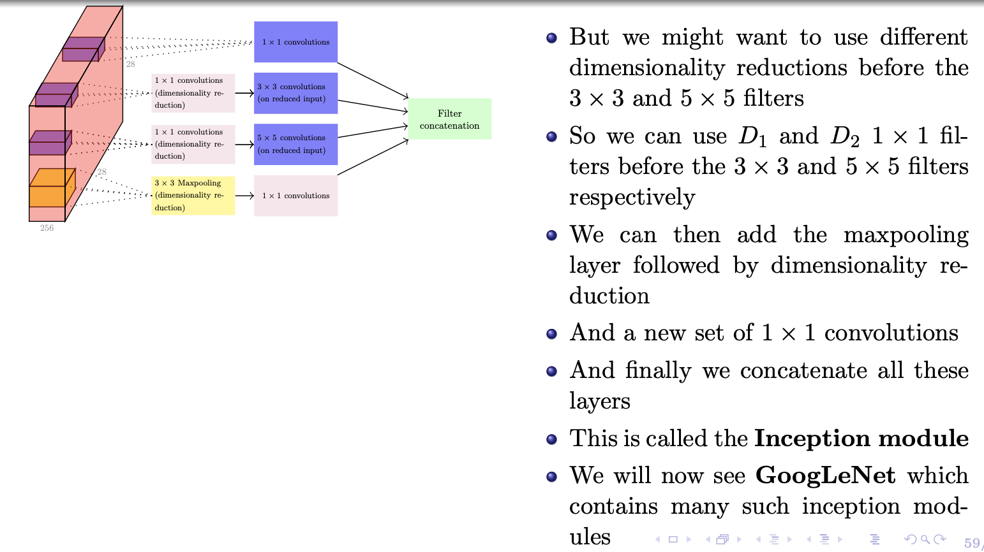
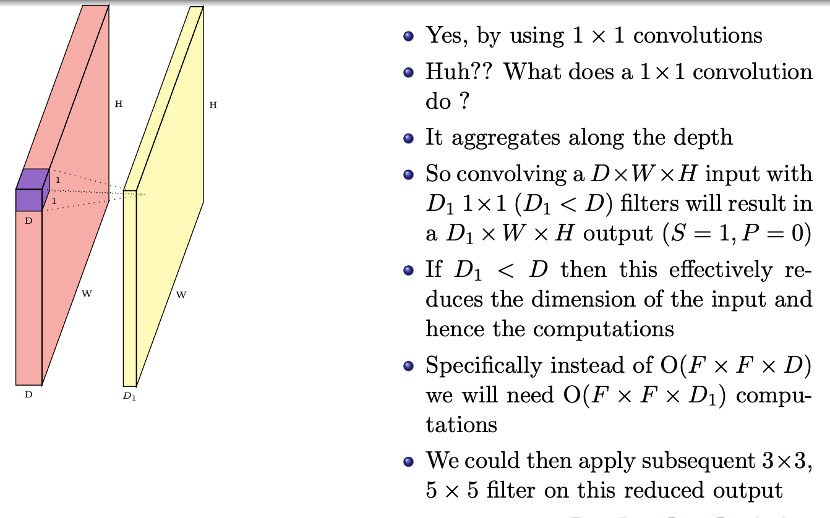
Idea behind GoogleNet

Slide 10
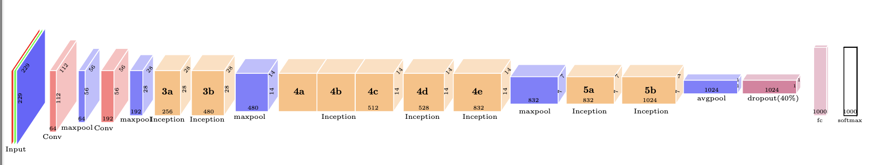
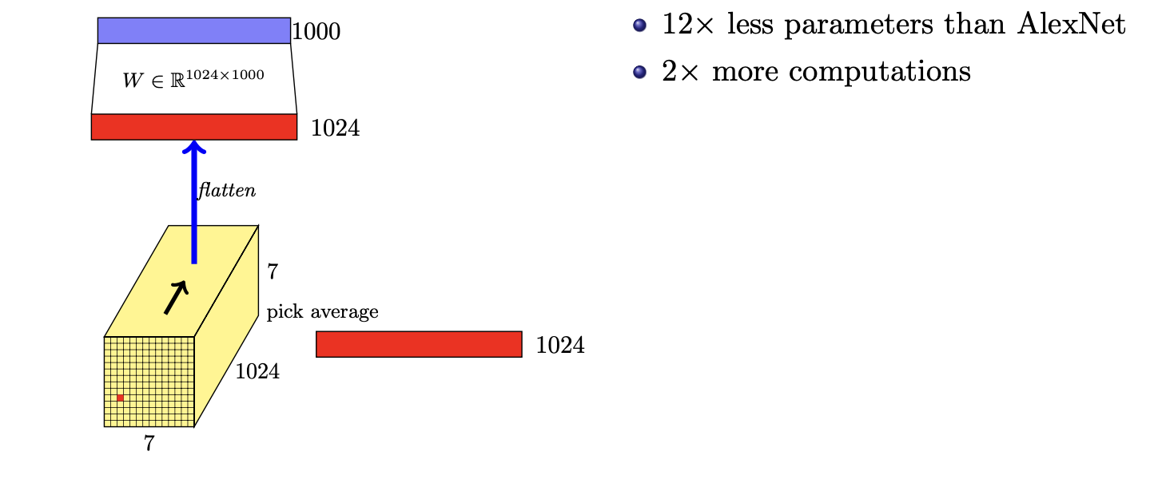
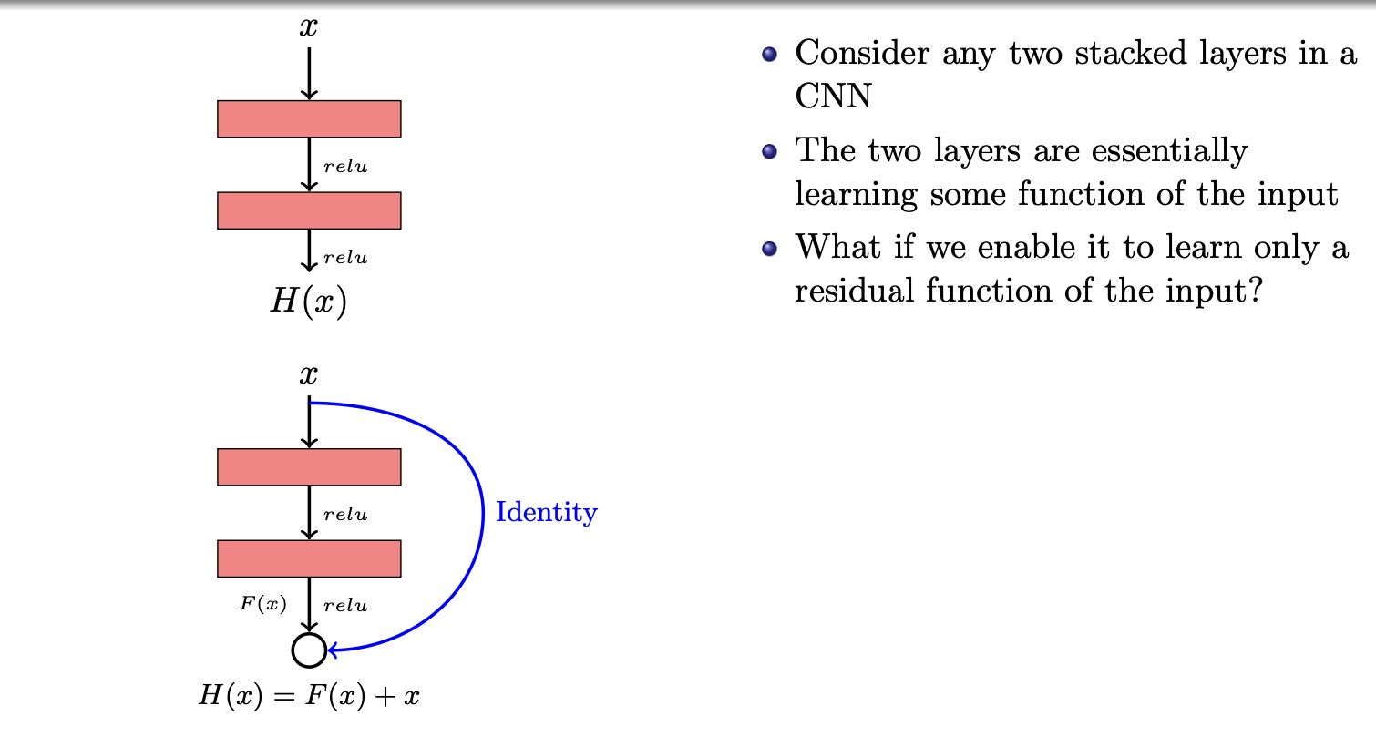
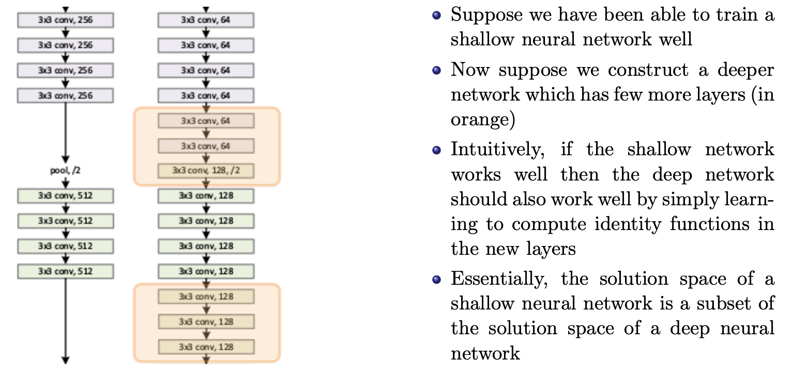
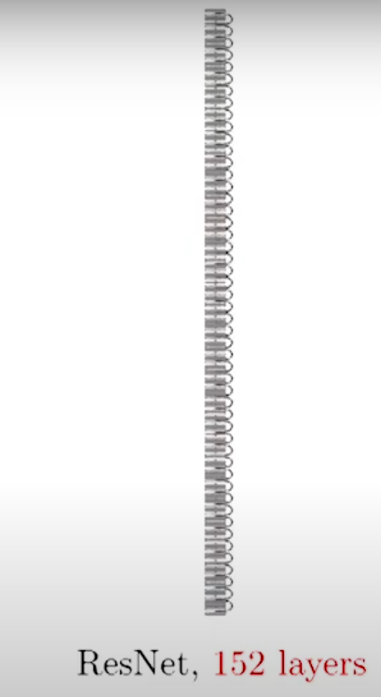
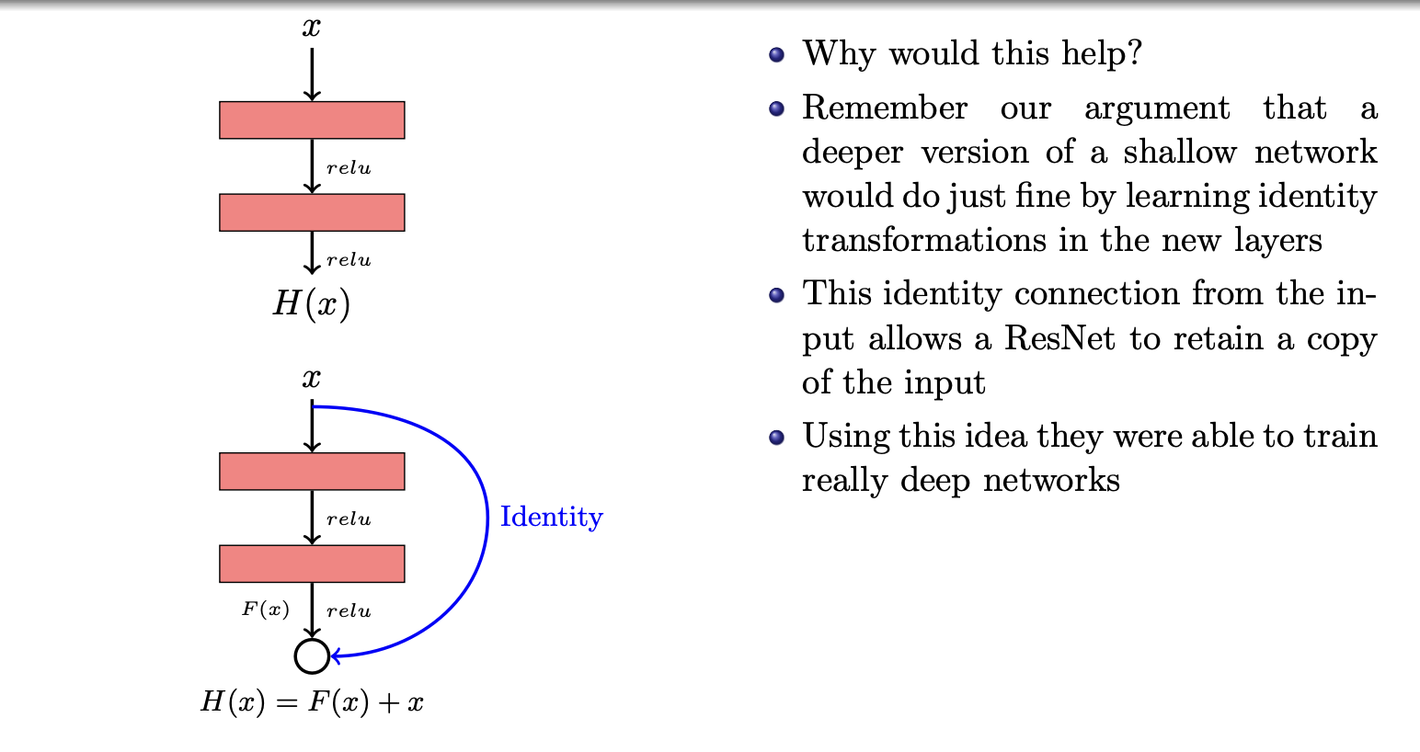
GoogleNet
GoogleNet vs. AlexNet
ResNet

Slide 11
Topics on which Week 10 Assignment Questions are based
Convolution Operation
Relation between input size, output size and filter size
Convolutional Neural Networks (CNN)
Training CNN
CNNs (success stories on ImageNet)
Visualizing Convolutional Neural Networks

Slide 12
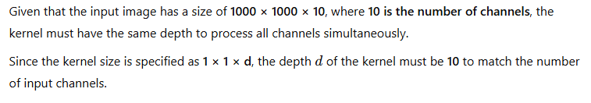
QUESTION 1
Consider an input image of size 1000×1000×10 where 10 refers to the number of channels (Such images do exist!). Suppose we want to apply a convolution operation on the entire image by sliding a kernel of size 1×1×d. What should be the depth d of the kernel?
SOLUTION 1
CORRECT ANSWER 1
10

Slide 13
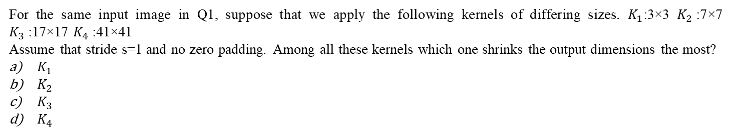
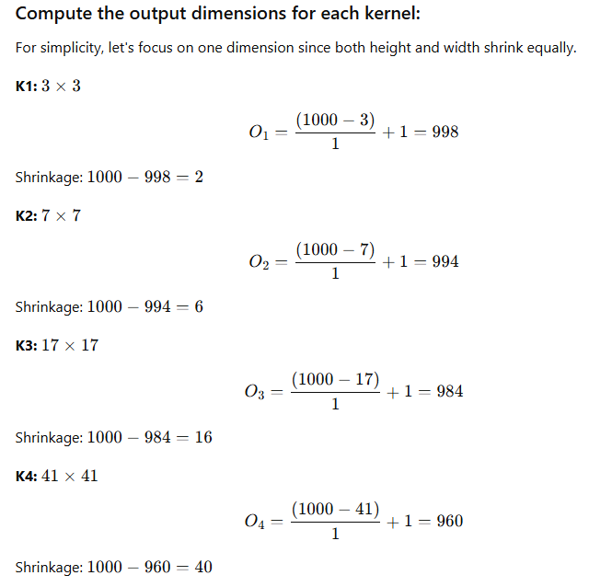
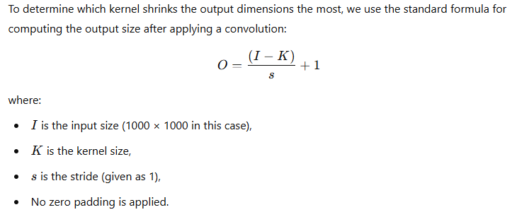
QUESTION 2
SOLUTION 2
CORRECT ANSWER 2
d)

Slide 14
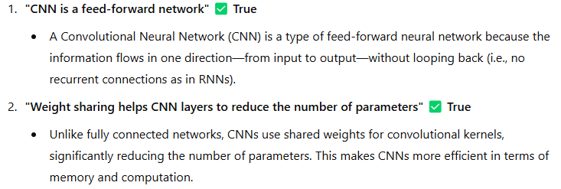
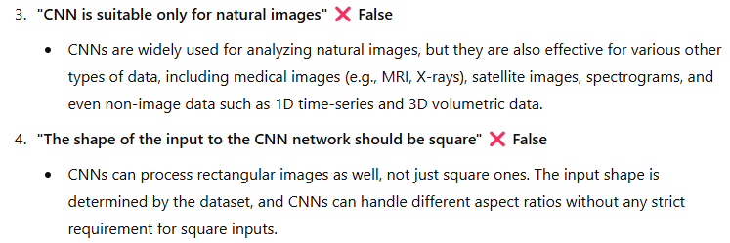
QUESTION 3
Which of the following statements about CNN is (are) true?
CNN is a feed-forward network
Weight sharing helps CNN layers to reduce the number of parameters
CNN is suitable only for natural images
The shape of the input to the CNN network should be square
SOLUTION 3
CORRECT ANSWER 3
a), b)

Slide 15
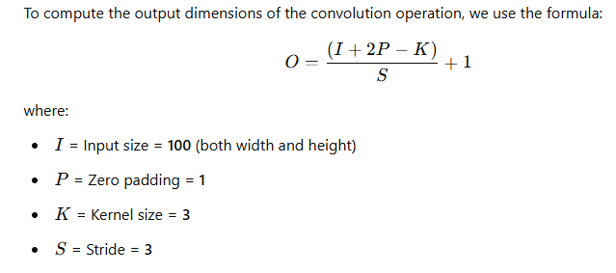
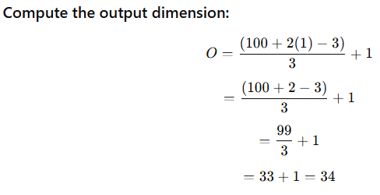
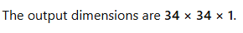
QUESTION 4
Consider an input image of size 100×100×1. Suppose that we used kernel of size 3×3, zero padding P=1 and stride value S=3. What will be the output dimension?
SOLUTION 4
CORRECT ANSWER 4
34

Slide 16
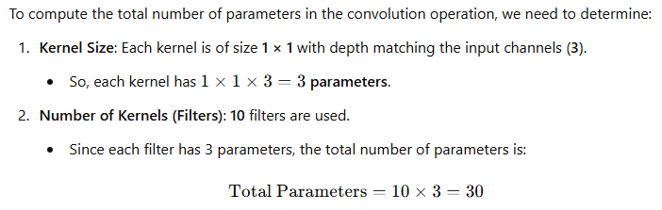
QUESTION 5
Consider an input image of size 100×100×3. Suppose that we use 10 kernels (filters) each of size 1×1, zero padding P=1 and stride value S=2. How many parameters are there? (assume no bias terms)
5
10
15
30
SOLUTION 5
CORRECT ANSWER 5
d)

Slide 17


QUESTION 6
Which statement is true about the size of filters in CNNs?
The size of the filter does not affect the features it captures.
The size of the filter only affects the computation time.
Larger filters capture more global features.
Smaller filters capture more local features.
SOLUTION 6
CORRECT ANSWER 6
c), d)

Slide 18


QUESTION 7
What is the motivation behind using multiple filters in one Convolution layer?
Reduced complexity of the network
Reduced size of the convolved image
Insufficient information
Each filter captures some feature of the image separately
SOLUTION 7
CORRECT ANSWER 7
d)

Slide 19

QUESTION 8
Which of the following architectures has the highest no. of layers?
AlexNet
GoogleNet
ResNet
VGG
SOLUTION 8
CORRECT ANSWER 8
c)

Slide 20

QUESTION 9
What is the purpose of guided backpropagation in CNNs?
To train the CNN to improve its accuracy on a given task.
To reduce the size of the input images in order to speed up computation.
To visualize which pixels in an image are most important for a particular class prediction.
None of the above.
SOLUTION 9
CORRECT ANSWER 9
c)

Slide 21



QUESTION 10
Which of the following statements is true regarding the occlusion experiment in a CNN?
It is a technique used to prevent overfitting in deep learning models.
It is used to increase the number of filters in a convolutional layer.
It is used to determine the importance of each feature map in the output of the network.
It involves masking a portion of the input image with a patch of zeroes.
SOLUTION 10
CORRECT ANSWER 10
c), d)

